Slide 1


Slide 2



Project Highlights
Project Name : Building a GUI for viewing data from Apache Kafka
Team Size : 3
Mentor Name: Vimal Komath Ps no : 954963
Team Members Details
Intern Name: Nandyala Naveen Kumar Reddy
PS#99003604
2002MYSEMBF1
BE in Electrical and Electronics
Intern Name: Satyasindhu Thummala
PS#99003534
2002MYSEMBF1
BE in Electrical and Electronics
Intern Name:
Vikram Hedge
PS#99003597
2002MYSEMBF1
BE in Electrical and Electronics

Slide 3

Apache Kafka
What is Kafka?
Kafka is a messaging system that is designed to be fast, scalable, and durable
Why Kafka?
Building real-time streaming data pipelines

Slide 4
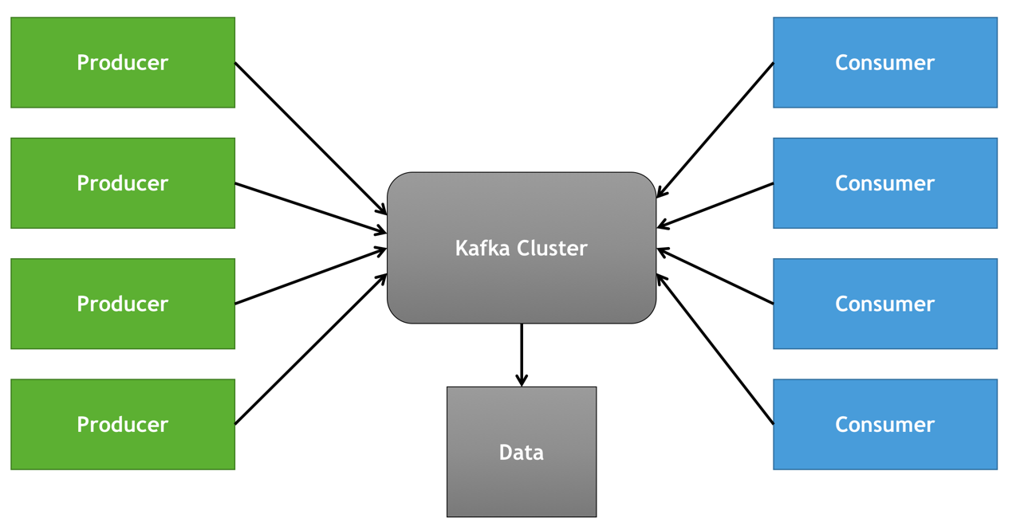
Main components of Kafka
Producers
Kafka cluster
consumers

Slide 5
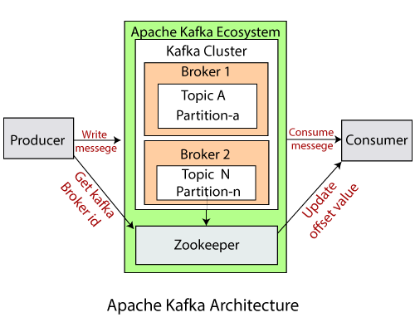
Kafka cluster
Brokers
Cluster
Topic
Partitions
Replication factor
Zookeeper

Slide 6
GUI:
The GUI was first developed at Xerox PARC by Alan Kay, Douglas Engelbart, and a group of other researchersin 1981 .
A GUI (graphical user interface) is a system of interactive visual components for computer software .
A GUI displays objects that convey information, and represent actions that can be taken by the user.
The objects change color, size, or visibility when the user interacts with them.

Slide 7
Software install:
Python PyCharm
Python
QT Designer
Pip3 install pyqt5
Pip3 install pyqt5-tools

Slide 8
Kafka server install:
Source download: kafka-2.7.0-src.tgz
Zookeeper command:
c:\kafka>.\bin\windows\zookeeper-server - start.bat.\config\zookeeper.properties
Server command:
c:\kafka>.\bin\windows\kafka-server-start.bat.\config\zookeeper.properties
Kafka manager:
c:\kafka>.\bin\windows\kafka –topic.bat –create –zookeeper localhost:2181 –replication –factor 1 –partition 1 –topic TestTopic
C:\kafka>.\bin\windows\kafka –topic.bat –list –zookeeper localhost:2181
List:
C:\kafka>.\bin\windows\kafka –console –producer.bat –broker-list localhost:9092 –topic TestTopic

Slide 9
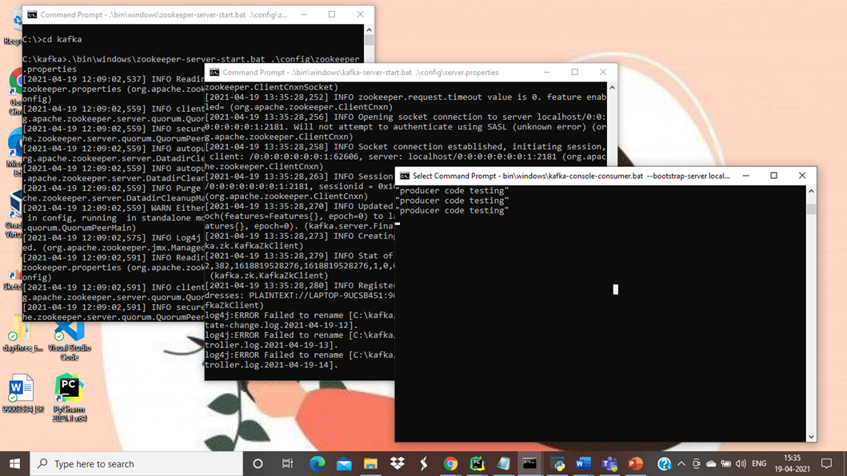
Kafka server

Slide 10
Kafka Producer coding
Configurations needed by producer to interface with Kafka server
bootstarp_server
topic
value_serializer
call of send method

Slide 11
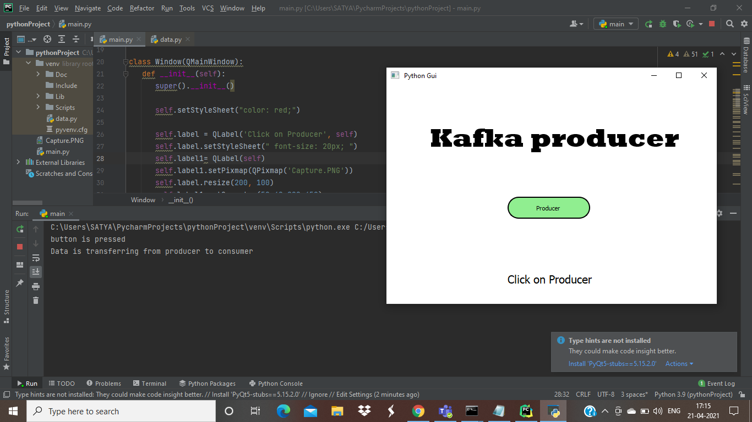
Kafka producer

Slide 12
Kafka consumer coding
Configurations needed by consumer to interface with Kafka server
Bootstrap_server
Topic
Auto_offset_reset
Group_id

Slide 13
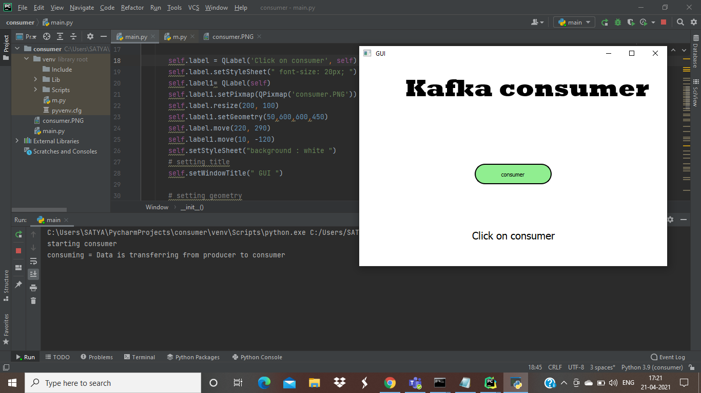
Kafka consumer

Slide 14
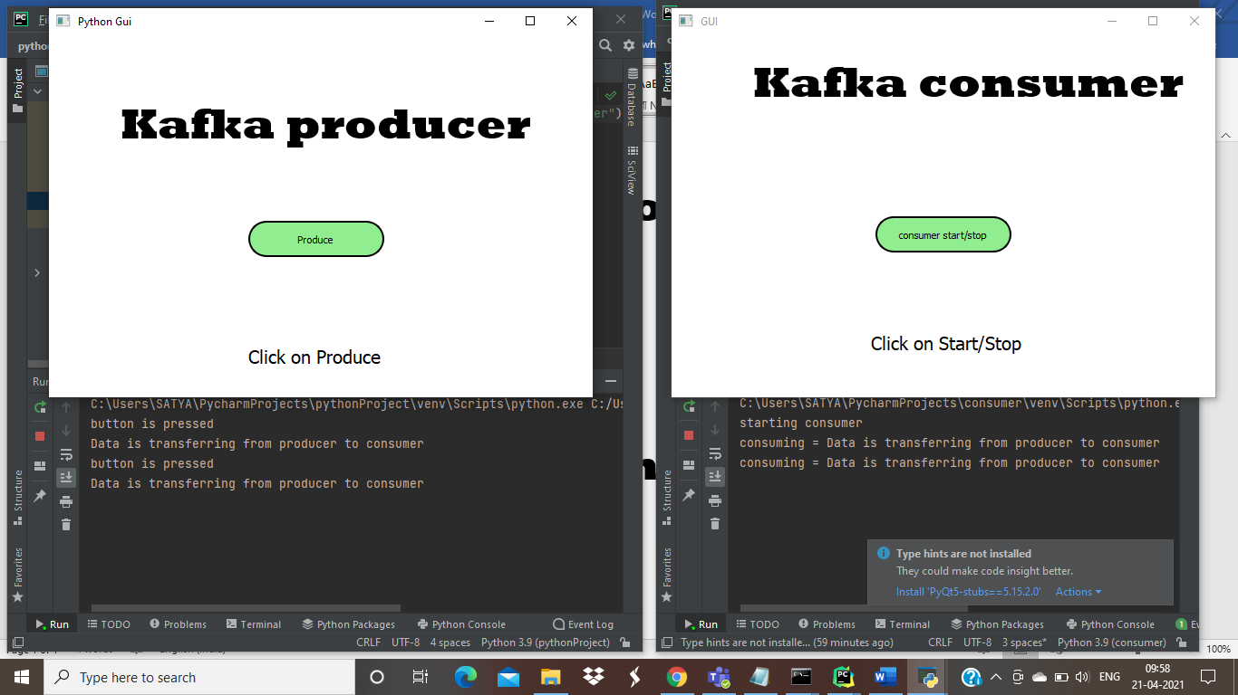
output

Slide 15
client and Kafka running on the different machines
Configurations required are :
server properties should be updated by adding
advertised. Listeners=PLAINTEXT://[ip.address]:9092
listeners=PLAINTEXT://0.0.0.0:9092
Ip address of the system where Kafka server is running.
On client system
bootstrap_server address should be change from local host to ip address of machine that is holding Kafka server

Slide 16
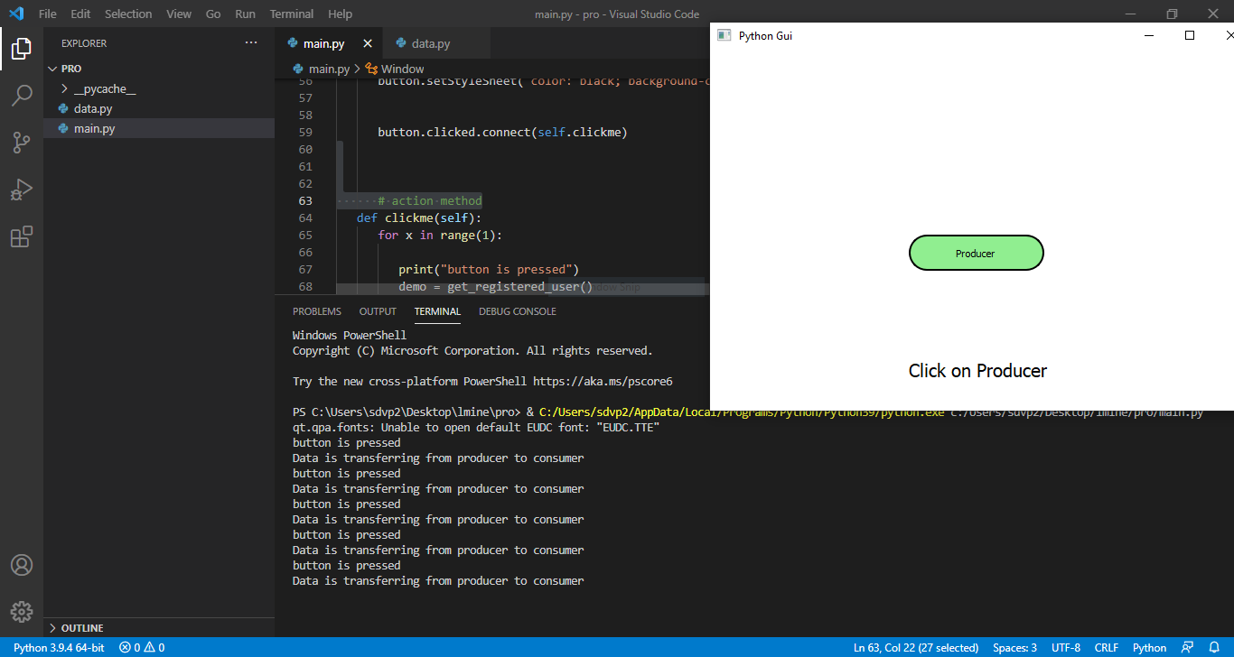
producer on different machine

Slide 17
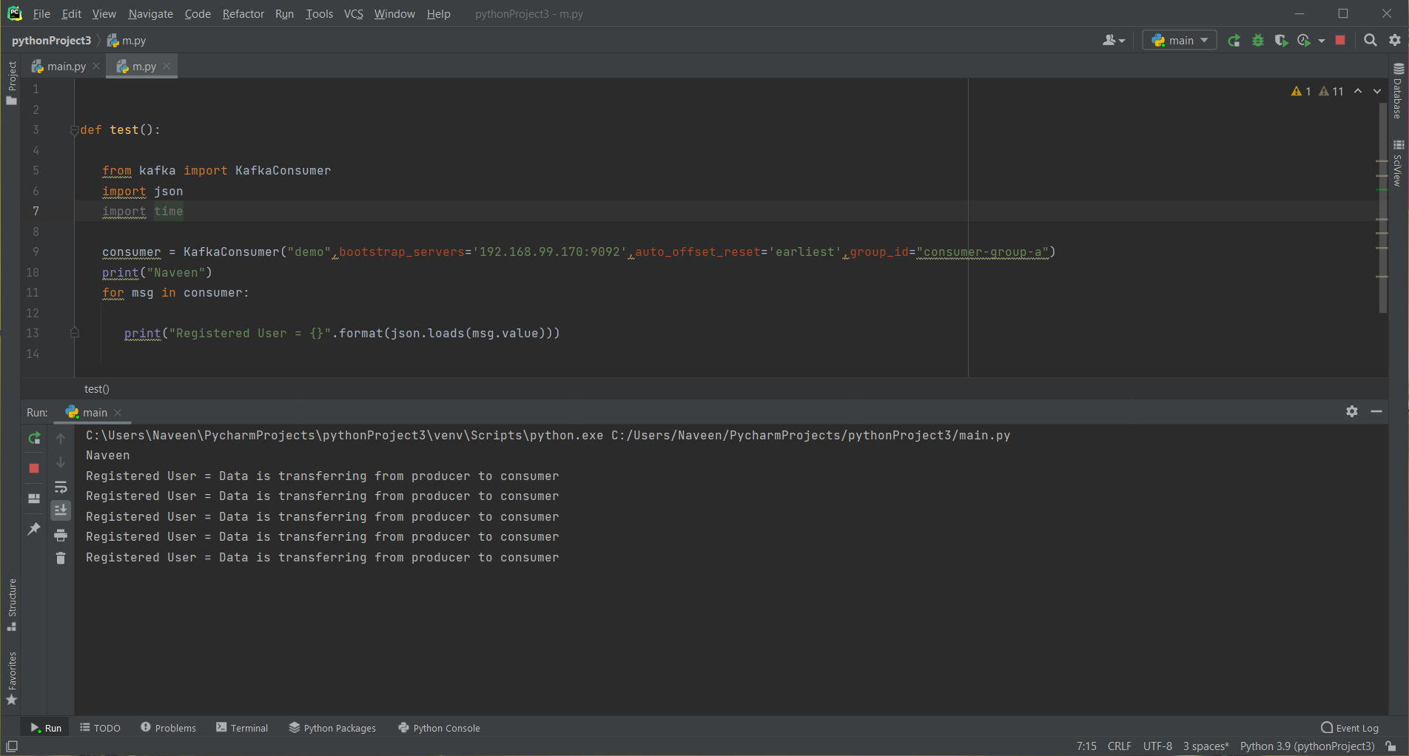
client on different machine

Slide 18

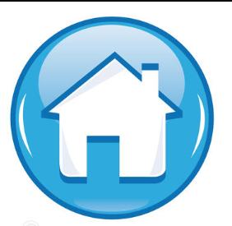
Thank You !

